Slide 1
flex
Ismaeel Alkrayyan
Department of AI ,4th year

Slide 2
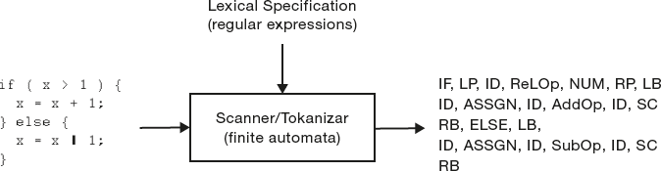
lexical analyzer
Scanner :
  This is the first phase of a compiler.
  reading a source text as a file of characters and dividing them up into tokens by matching sequential characters to patterns.
  Filtering comment lines and white space characters. white space characters like tab, space, newline characters.
A quick tutorial on fLex

Slide 3
Tokens, Patterns, Lexemes
  Token: It is a group of characters with logical meaning. Token is a logical building block of the language .Example: id, keyword,Num
  Pattern: It is a rule that describes the character that can be grouped into tokens. It is expressed as a regular expression. Input stream of characters are matched with patterns and tokens are identified.
  Lexeme: It is the actual text/character stream that matches with the pattern and is recognized as a token.
      For example, “int” is identified as token keyword. Here “int” is lexeme and keyword is token
A quick tutorial on fLex

Slide 4
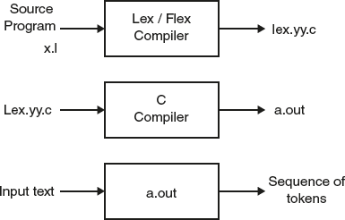
flex : Overview
Scanner generators:
  Helps write programs whose control flow is directed by instances of regular expressions in the input stream.
Output: C code implementing a scanner:
  function: yylex()
  file: lex.yy.c
Input: a set of regular expressions + actions
flex (or lex)
A quick tutorial on Lex

Slide 5

Using flex
file: lex.yy.c
lex input spec (regexps + actions)
yylex()
{
…
}
flex
compiler
user supplies
driver code
main() {…}
or
parser() {…}
A quick tutorial on Lex

Slide 6
flex: input format
An input file has the following structure:
definitions
%%
rules
%%
user code
required
optional
Shortest possible legal flex input:
%%
A quick tutorial on Lex

Slide 7
Definitions
%option noyywrap
%{
#include<stdio.h>
#include<stdlib.h>
int line_count=0;
%}
whitespace [ \t\v\f\r]+
Newline [\n]
DIGIT [0-9]
CommentStart "/*"
ID [a-zA-Z][a-zA-Z0-9]*
%%
Options
C Code
Flex Definitions
A quick tutorial on Lex

Slide 8
Rules
The rules portion of the input contains a sequence of rules.
Each rule has the form
  pattern action
  where:
  pattern describes a pattern to be matched on the input
  pattern must be un-indented
  action must begin on the same line.
A quick tutorial on fLex

Slide 9
Rules
%%
[0-9]+ {printf("%s is a number",yytext);}
{whitespace} {printf("whitespace encountered");}
{newline} {line_count++;}
. {printf("Mysterious character found");}
%%
Pattern
Action
Patterns extended regular expressions.
Do not place any whitespace at the beginning of a pattern line.
“start conditions” can be used to specify that a pattern match only in specific situations.

Slide 10
Patterns
Essentially, extended regular expressions.
  <<EOF>> to match “end of file”
  Character classes:
    [:alpha:], [:digit:], [:alnum:], [:space:].
  {name} where name was defined earlier.
“start conditions” can be used to specify that a pattern match only in specific situations.
A quick tutorial on Lex

Slide 11
Regular Expressions
The patterns at the heart of every flex scanner use a rich regular expression language.
A regular expression is a pattern description using a metalanguage. a language that you use to describe what you want the pattern to match
The metalanguage uses standard text characters, some of which represent themselves and others of which represent patterns.
All characters other than the metacharacter, including all letters and digits, match themselves.
A quick tutorial on Lex

Slide 12
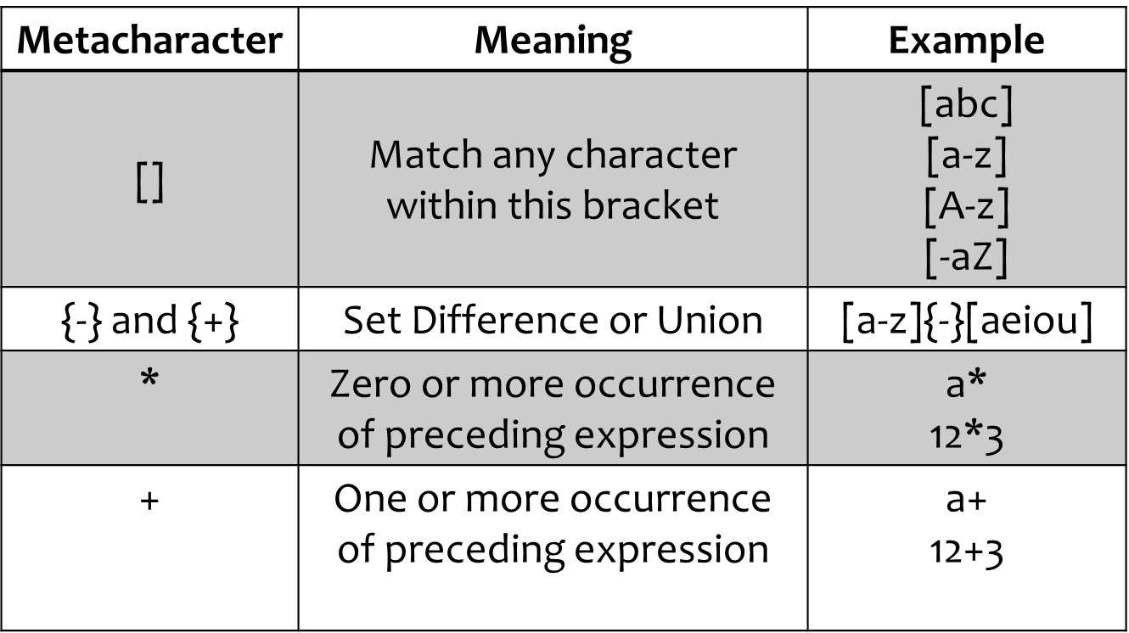
Regular Expressions
A quick tutorial on Lex

Slide 13
Regular Expressions
Metacharacter | Meaning | Example
. | Matches any single character except the newline character (\n).
\ | Used to escape metacharacters and as part of the usual C escape sequences; | \n is a newline \* is a literal asterisk.
/ | Trailing context, which means to match the regular expression preceding the slash but only if followed by the regular expression after the slash. Only one slash is permitted per pattern. | 0/1 matches 0 in the string 01 but would not match anything in the string 0 or 02.
A quick tutorial on Lex

Slide 14
Regular Expressions
Metacharacter | Meaning | Example
? | Zero or one occurrence of preceding expression | -?[0-9]+
{} | To specify already defined names To specify number of occurrance | {whitespace} 1{2}3{4}5{6}
| | Or | a|b faith|hope|charity
() | Group series of regular expression together | (ab|cd)+
A quick tutorial on Lex

Slide 15
Regular Expressions
Metacharacter | Meaning | Example
^ | If within [], then means except following characters Otherwise means start of line | [^ab] ^ab
$ | End of line | 124$
“” | Match anything literally | “^124$”
<<EOF>> | End of file
A quick tutorial on Lex

Slide 16
Regular Expressions
complex number pattern with
    exponent part is optional.
    optional decimal point.
    optional sign.
[-+]?([0-9]*\.?[0-9]+|[0-9]+\.)(E(+|-)?[0-9]+)?

Slide 17
Example
A flex program to read a file of (positive) integers and compute the average:
%{
#include <stdio.h>
#include <stdlib.h>
%}
dgt [0-9]
%%
{dgt}+ return atoi(yytext);
%%
void main()
{
int val, total = 0, n = 0;
while ( (val = yylex()) > 0 ) {
total += val;
n++;
}
if (n > 0) printf(“ave = %d\n”, total/n);
}
Definition for a digit
definitions
Rule to match a number and return its value to the calling routine
rules
Driver code
(could instead have been in a separate file)
user code
A quick tutorial on Lex

Slide 18
Example
A flex program to read a file of (positive) integers and compute the average:
%{
#include <stdio.h>
#include <stdlib.h>
%}
dgt [0-9]
%%
{dgt}+ return atoi(yytext);
%%
void main()
{
int val, total = 0, n = 0;
while ( (val = yylex()) > 0 ) {
total += val;
n++;
}
if (n > 0) printf(“ave = %d\n”, total/n);
}
defining and using a name
definitions
rules
user code
A quick tutorial on Lex

Slide 19
Example
A flex program to read a file of (positive) integers and compute the average:
%{
#include <stdio.h>
#include <stdlib.h>
%}
dgt [0-9]
%%
{dgt}+ return atoi(yytext);
%%
void main()
{
int val, total = 0, n = 0;
while ( (val = yylex()) > 0 ) {
total += val;
n++;
}
if (n > 0) printf(“ave = %d\n”, total/n);
}
defining and using a name
definitions
char * yytext;
  a buffer that holds the input characters that actually match the pattern
rules
user code
A quick tutorial on Lex

Slide 20
Example
A flex program to read a file of (positive) integers and compute the average:
%{
#include <stdio.h>
#include <stdlib.h>
%}
dgt [0-9]
%%
{dgt}+ return atoi(yytext);
%%
void main()
{
int val, total = 0, n = 0;
while ( (val = yylex()) > 0 ) {
total += val;
n++;
}
if (n > 0) printf(“ave = %d\n”, total/n);
}
defining and using a name
definitions
char * yytext;
  a buffer that holds the input characters that actually match the pattern
rules
Invoking the scanner: yylex()
  Each time yylex() is called, the scanner continues processing the input from where it last left off.
  Returns 0 on end-of-file.
user code
A quick tutorial on Lex

Slide 21
Frequently encountered terms
yywrap() :
  When a lex scanner reached the end of yyin, it called yywrap(). The idea was that if there was another input file, yywrap could adjust yyin and return 0 to resume scanning.
  If that was really the end of the input, it returned 1 to the scanner to say that it was done
  Modern versions of flex let you say %option noyywrap at the top of your scanner to tell it not to call yywrap, and from here on, we’ll always do that.
Yyin: a scanner reads from the stdio FILE called yyin, so to read a single file, you need only set it before the first call to yylex.
A quick tutorial on Lex

Slide 22
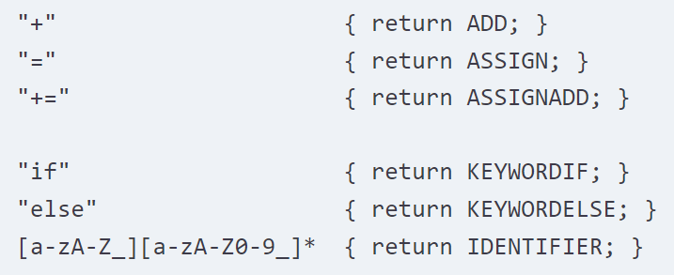
Matching the Input (Handles Ambiguous Patterns)
When more than one pattern can match the same input, the scanner behaves as follows:
  Match the longest possible string every time the scanner matches input.
  if multiple rules match, the rule listed first in the flex input file is chosen;
  if no rule matches, the default is to copy the next character to stdout.
The text that matched (the “token”) is copied to a buffer yytext.
rules
A quick tutorial on Lex

Slide 23
Matching the Input (cont’d)
Pattern to match C-style comments: /* … */
"/*"(.|\n)*"*/"
Input:
#include <stdio.h> /* definitions */
int main(int argc, char * argv[ ]) {
if (argc <= 1) {
printf(“Error!\n”); /* no arguments */
}
printf(“%d args given\n”, argc);
return 0;
}
A quick tutorial on Lex

Slide 24
Matching the Input (cont’d)
Pattern to match C-style comments: /* … */
"/*"(.|\n)*"*/"
Input:
#include <stdio.h> /* definitions */
int main(int argc, char * argv[ ]) {
if (argc <= 1) {
printf(“Error!\n”); /* no arguments */
}
printf(“%d args given\n”, argc);
return 0;
}
longest match:
A quick tutorial on Lex

Slide 25
Matching the Input (cont’d)
Pattern to match C-style comments: /* … */
"/*"(.|\n)*"*/"
Input:
#include <stdio.h> /* definitions */
int main(int argc, char * argv[ ]) {
if (argc <= 1) {
printf(“Error!\n”); /* no arguments */
}
printf(“%d args given\n”, argc);
return 0;
}
longest match:
Matched text shown in blue
A quick tutorial on Lex

Slide 26
Start Conditions
Used to activate rules conditionally.
  Any rule prefixed with <S> will be activated only when the scanner is in start condition S.
Declaring a start condition S:
  in the definition section: %x S
    “%x” specifies “exclusive start conditions”
Putting the scanner into start condition S:
  action: BEGIN(S)
A quick tutorial on Lex

Slide 27
Start Conditions (cont’d)
Example:
  <STRING>[^"]* { …match string body… }
    [^"] matches any character other than "
    The rule is activated only if the scanner is in the start condition STRING.
INITIAL refers to the original state where no start conditions are active.
<*> matches all start conditions.
A quick tutorial on Lex

Slide 28
Using Start Conditions
Start conditions let us explicitly simulate finite state machines.
This lets us get around the “longest match” problem for C-style comments.
FSA for C comments:
flex input:
%x S1, S2, S3
%%
"/" BEGIN(S1);
<S1>"*" BEGIN(S2);
<S2>[^*] ; /* stay in S2 */
<S2>"*" BEGIN(S3);
<S3>"*" ; /* stay in S3 */
<S3>[^*/] BEGIN(S2);
<S3>"/" BEGIN(INITIAL);
non-*
*
/
*
*
/
S1
S2
S3
non-{ /,* }
A quick tutorial on Lex

Slide 29
Using Start Conditions
Start conditions let us explicitly simulate finite state machines.
This lets us get around the “longest match” problem for C-style comments.
FSA for C comments:
flex input:
%x S1, S2, S3
%%
"/" BEGIN(S1);
<S1>"*" BEGIN(S2);
<S2>[^*] ; /* stay in S2 */
<S2>"*" BEGIN(S3);
<S3>"*“ ; /* stay in S3 */
<S3>[^*/] BEGIN(S2);
<S3>"/" BEGIN(INITIAL);
non-*
*
/
*
*
/
S1
S2
S3
non-{ /,* }
A quick tutorial on Lex

Slide 30
Using Start Conditions
Start conditions let us explicitly simulate finite state machines.
This lets us get around the “longest match” problem for C-style comments.
FSA for C comments:
flex input:
%x S1, S2, S3
%%
"/" BEGIN(S1);
<S1>"*" BEGIN(S2);
<S2>[^*] ; /* stay in S2 */
<S2>"*" BEGIN(S3);
<S3>"*“ ; /* stay in S3 */
<S3>[^*/] BEGIN(S2);
<S3>"/" BEGIN(INITIAL);
non-*
*
/
*
*
/
S1
S2
S3
non-{ /,* }
A quick tutorial on Lex

Slide 31
Using Start Conditions
Start conditions let us explicitly simulate finite state machines.
This lets us get around the “longest match” problem for C-style comments.
FSA for C comments:
flex input:
%x S1, S2, S3
%%
"/" BEGIN(S1);
<S1>"*" BEGIN(S2);
<S2>[^*] ; /* stay in S2 */
<S2>"*" BEGIN(S3);
<S3>"*“ ; /* stay in S3 */
<S3>[^*/] BEGIN(S2);
<S3>"/" BEGIN(INITIAL);
non-*
*
/
*
*
/
S1
S2
S3
non-{ /,* }
A quick tutorial on Lex

Slide 32
Using Start Conditions
Start conditions let us explicitly simulate finite state machines.
This lets us get around the “longest match” problem for C-style comments.
FSA for C comments:
flex input:
%x S1, S2, S3
%%
"/" BEGIN(S1);
<S1>"*" BEGIN(S2);
<S2>[^*] ; /* stay in S2 */
<S2>"*" BEGIN(S3);
<S3>"*“ ; /* stay in S3 */
<S3>[^*/] BEGIN(S2);
<S3>"/" BEGIN(INITIAL);
non-*
*
/
*
*
/
S1
S2
S3
non-{ /,* }
A quick tutorial on Lex

Slide 33
Using Start Conditions
Start conditions let us explicitly simulate finite state machines.
This lets us get around the “longest match” problem for C-style comments.
FSA for C comments:
flex input:
%x S1, S2, S3
%%
"/" BEGIN(S1);
<S1>"*" BEGIN(S2);
<S2>[^*] ; /* stay in S2 */
<S2>"*" BEGIN(S3);
<S3>"*“ ; /* stay in S3 */
<S3>[^*/] BEGIN(S2);
<S3>"/" BEGIN(INITIAL);
non-*
*
/
*
*
/
S1
S2
S3
non-{ /,* }
A quick tutorial on Lex

Slide 34
Using Start Conditions
Start conditions let us explicitly simulate finite state machines.
This lets us get around the “longest match” problem for C-style comments.
FSA for C comments:
flex input:
%x S1, S2, S3
%%
"/" BEGIN(S1);
<S1>"*" BEGIN(S2);
<S2>[^*] ; /* stay in S2 */
<S2>"*" BEGIN(S3);
<S3>"*“ ; /* stay in S3 */
<S3>[^*/] BEGIN(S2);
<S3>"/" BEGIN(INITIAL);
non-*
*
/
*
*
/
S1
S2
S3
non-{ /,* }
A quick tutorial on Lex

Slide 35
Using Start Conditions
Start conditions let us explicitly simulate finite state machines.
This lets us get around the “longest match” problem for C-style comments.
FSA for C comments:
flex input:
%x S1, S2, S3
%%
"/" BEGIN(S1);
<S1>"*" BEGIN(S2);
<S2>[^*] ; /* stay in S2 */
<S2>"*" BEGIN(S3);
<S3>"*“ ; /* stay in S3 */
<S3>[^*/] BEGIN(S2);
<S3>"/" BEGIN(INITIAL);
non-*
*
/
*
*
/
S1
S2
S3
non-{ /,* }
A quick tutorial on Lex

Slide 36
Common Token in Python language
Identifiers : Examples (variableName , functionName , ClassName…).
Keywords: Examples (def, class , for , in , pass …).
Literals : Examples (‘Hello, World!’, “Hello, World!” …).
Operators : Examples (+,-,*,/,=,+=,-=,>,<,>=,<=,and,not,in,….).
Delimiters : Examples ((),[],{}).
Indentation : 4 spaces by convention or tab
dedentaion
Comments : #hero comments
Whitespace : space,tab
Line Continuation :’\’ is used to continue a statement across multiple lines.
A quick tutorial on Lex

Slide 37
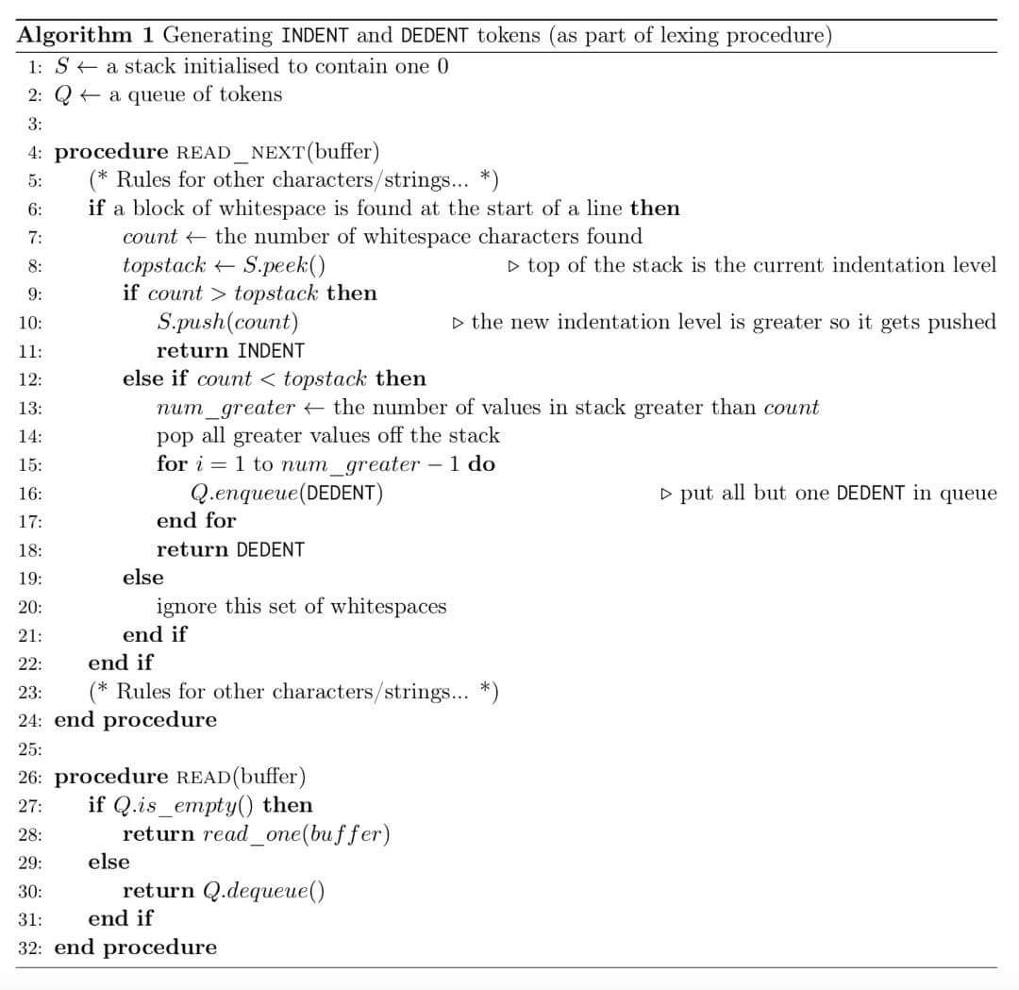
Algorithm Generating INDENT and DEDENT TOKEN
A quick tutorial on Lex

Slide 38
Putting it all together
Scanner implemented as a function
    int yylex();
  return value indicates type of token found (encoded as a +ve integer);
  the actual string matched is available in yytext.
Scanner and parser need to agree on token type encodings
  let bison generate the token type encodings
    bison places these in a file y.tab.h
  use “#include y.tab.h” in the definitions section of the flex input file.
A quick tutorial on Lex

